Slide 1
Inheritance
Inheritance is one of the major pillar of Object-oriented approach.
Inheritance allows creation of hierarchical classification.
Why Inheritance?
Reusability
Extensibility

Slide 2
Inheritance in Java is a mechanism in which one object acquires all the properties and behaviors of a parent object. It is an important part of OOPs (Object Oriented programming system).
The idea behind inheritance in Java is that you can create new classes that are built upon existing classes. When you inherit from an existing class, you can reuse methods and fields of the parent class. Moreover, you can add new methods and fields in your current class also.
Inheritance represents the IS-A relationship which is also known as a parent-child relationship.
Why use inheritance in java
For Method Overriding (so runtime polymorphism can be achieved).
For Code Reusability.

Slide 3
Terms used in Inheritance
Class: A class is a group of objects which have common properties. It is a template or blueprint from which objects are created.
Sub Class/Child Class: Subclass is a class which inherits the other class. It is also called a derived class, extended class, or child class.
Super Class/Parent Class: Superclass is the class from where a subclass inherits the features. It is also called a base class or a parent class.
Reusability: As the name specifies, reusability is a mechanism which facilitates you to reuse the fields and methods of the existing class when you create a new class. You can use the same fields and methods already defined in the previous class.

Slide 4
The syntax of Java Inheritance
class Subclass-name extends Superclass-name
{
//methods and fields
}
The extends keyword indicates that you are making a new class that derives from an existing class. The meaning of "extends" is to increase the functionality.

Slide 5
Derived class Constructor
Constructors are called in the sequence of
super-->sub
When Manager is created the sequence in which constructors get invoked is
Employee🡪Manager
Notes:
‹#›

Slide 6
super Keyword
super keyword refers to super class.
super allows to pass control to a constructor in the super class.
Every constructor must invoke the constructor of super class.
If constructor is not invoked explicitly, super class uses its default constructor.
If there’s no default constructor in super class, compiler complains.
super must be the first statement in the sub class’s constructor.

Slide 7
protected keyword
protected keyword is used in inheritance.
Accessibility of protected keyword is within a package anywhere and out side the package only with inherited class.

Slide 8
Polymorphism
Polymorphism support resolves the method call to suitable implementation.
Why Polymorphism?
Polymorphism allows to design and implement system that are more easily extensible and maintainable.

Slide 9
Early Binding and Late Binding
The binding of a member function call with an object is called compile time or static type or early binding.
Static polymorphism is achieved by method overloading in java.
The binding of the function call to an object at run time is called run time or dynamic binding or late binding.
Dynamic polymorphism is achieved by method overriding in an inheritance.
Notes:
Binding is the process of associating a function call to the function definition. There are two types of binding namely compile time binding and late binding.
Early Binding
When the binding occurs at compile time, it is known as compile time binding or early binding. All the methods called on object or class name are examples of compile time binding.
Late Binding
When the binding process occurs at run time, it is called late binding. The arguments passed to the method written in client code causes the appropriate method to be invoked at run time. These arguments are the instance (an object) on which to invoke the method, the name of the invoked method (a string), and the arguments passed to the invoked method (an array of objects).

Slide 10
Method Overloading vs Overriding
 | Overloading | Overriding
Scope | Generally done in same class | In the inherited classes
Purpose | Handy for program design as different method names need not be remembered | Message is same but its implementation needs to be specific to the derived class
Signature of methods | Different for each method overloaded | Has to be same in derived class as in base class
Return Type | Can be same or different as it is not considered | Return type also needs to be same

Slide 11
Method Overriding
Polymorphism is achieved using overriding functions using inheritance.
It gives ability to define a behavior that's specific to the sub class type based on its requirement.
The version of a method that is executed will be determined by the object that is used to invoke a method.
Parent object parent method
Child object child method
Notes:
‹#›

Slide 12
Method Overriding
class Employee
{
public double calculateSalary()
{
return basicsal + hra + da;
}
}
class Manager extends Employee
{ public double
calculateSalary()
{
return (basicsal +
hra+da+allowances);
}
public static void main(string[] args)
{
Manager mngr = new Manager();
System.out.println(mngr.calculateSalary());
Employee empl = new Employee();
System.out.println(empl.calculateSalary());
}
}

Slide 13
Upcasting and downcasting in Java are the two forms of typecasting.
The purpose of typecasting is to enable a function in a program to process the variables correctly.
Upcasting refers to typecasting a child object to a parent object.
Downcasting provides casting a parent object to a child object.
Implicit downcasting is not allowed in Java
Syntax for upcasting: Parent p = new Child();
Syntax for downcasting: Child c1 = (Child)p;

Slide 14
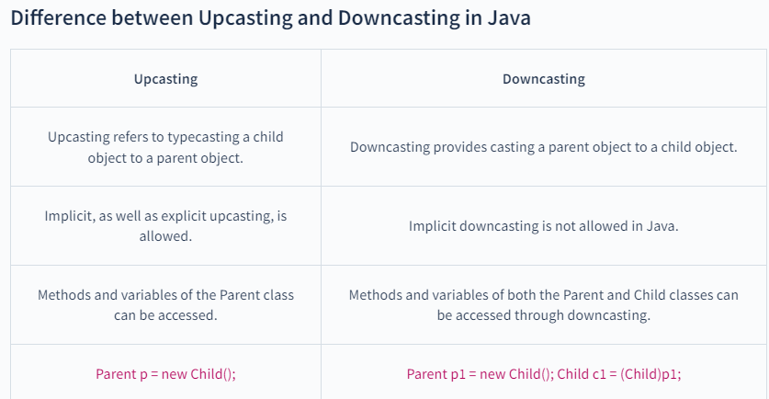

Slide 15
Dynamic Data Type Governs Method selection
Every reference variable has two types static and dynamic.
for e.g.
Employee ref=new Manager();
Here ‘ref’ has static data type Employee and ref has dynamic data type Manager.
Lets Create an array of Emp’s:
Emp e[]=new Emp[3];
e[0]=new Emp();
e[1]=new WageEmp();
e[2]=new SalesPerson();
Notes:
It is the opposite side of the design coin.
The main purpose of a sealed class to take away the inheritance feature from the user so they cannot derive a class from a sealed class. One of the best usage of sealed classes is when you have a class with static members. For example, the Pens and Brushes classes of the System.Drawing namespace. The Pens class represent the pens for standard colors. This class has only static members. For example, Pens.Blue represents a pen with blue color. Similarly, the Brushes class represents standard brushes. The Brushes.Blue represents a brush with blue color. So when you're designing your application, you may keep in mind that you have sealed classes to seal user's boundaries. IMP.
Genreally in real world enviornment the third party rendors can use .Net dll files and inherit the classes by creating a new software.so in this case to protect the classes declare as sealed and protected access modifiers.Sealed class is also useful to restrict the hierarchy of inheritance.

Slide 16
instanceof operator
Why instanceof operator?
Identifying dynamic data type of an Object.
To access objects polymorphically.
Java runtime keeps track of the class to which each object belongs.
This information is used by java to select the correct methods to execute at run time.
Employee emp = new Manager();
if(emp instanceof Manager)
{
// call to a method
}

Slide 17
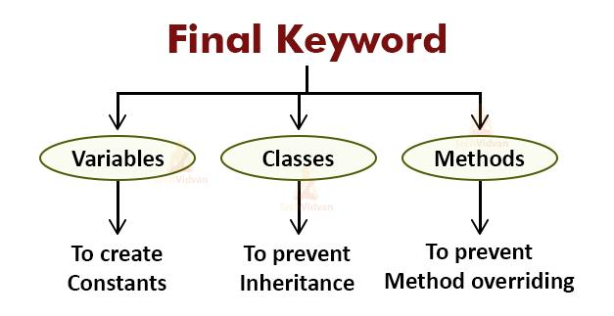

Slide 18
Final method and classes
A final method can not be overridden in a sub class.
private methods are implicitly final.
A class declared as a final cannot be subclassed.
Every method of a final class is by default final.

Slide 19
Final class and method
class Parent
{
public final void aMethod()
{
System.out.println(“in side Parent method”);
}
}
class Child extends Parent
{
public void aMethod()
{
System.out.println(“in side Child method”);
}
}
//can not be overridden in a sub class
final class Parent
{
public void aMethod()
{
System.out.println(“in side Parent method”);
}
}
class Child extends Parent
{
public void aMethod()
{
System.out.println(“in side Child method”);
}
}
//A final class cannot be subclassed

Slide 20
Object class
Object class is cosmic super class.
Every class in Java implicitly extends Object.
A variable of type Object can be used to refer to objects of any type.
e.g
Available in java.lang package
Object obj=new Employee();
Notes:
It is the opposite side of the design coin.
The main purpose of a sealed class to take away the inheritance feature from the user so they cannot derive a class from a sealed class. One of the best usage of sealed classes is when you have a class with static members. For example, the Pens and Brushes classes of the System.Drawing namespace. The Pens class represent the pens for standard colors. This class has only static members. For example, Pens.Blue represents a pen with blue color. Similarly, the Brushes class represents standard brushes. The Brushes.Blue represents a brush with blue color. So when you're designing your application, you may keep in mind that you have sealed classes to seal user's boundaries. IMP.
Genreally in real world enviornment the third party rendors can use .Net dll files and inherit the classes by creating a new software.so in this case to protect the classes declare as sealed and protected access modifiers.Sealed class is also useful to restrict the hierarchy of inheritance.

Slide 21
Methods of Object super class
Method | Use of method
public String toString() | Returns a String that represents the value of an object on which it is invoked.
public boolean equals(Object obj) | Checks whether one object is equal to another. (whether two references point to same memory area)
public int hashCode() | Method will return memory location of an object i.e. distinct integers for distinct objects.
public final Class getClass() | Returns the runtime class of an object.
protected void finalize() | Performs termination housekeeping on the object just before java garbage collects the object.
protected Object clone() | Creates and returns a copy of the object.
public final void wait(long timeout) | Causes current thread to wait until it receives notification.
public final void notify() | Wakes up a single thread that is waiting on object's monitor.
public final void notifyAll() | Wakes up all threads that are waiting on object's monitor.

Slide 22
Abstract class in Java
A class which is declared as abstract is known as an abstract class. It can have abstract and non-abstract methods. It needs to be extended and its method implemented. It cannot be instantiated.
Points to Remember
An abstract class must be declared with an abstract keyword.
It can have abstract and non-abstract methods.
It cannot be instantiated.
It can have constructors and static methods also.
It can have final methods which will force the subclass not to change the body of the method.

Slide 23
Nested Class(Inner Class)
Java inner class or nested class is a class that is declared inside the class or interface.
We use inner classes to logically group classes and interfaces in one place to be more readable and maintainable.
Additionally, it can access all the members of the outer class, including private data members and methods.

Slide 24
Types of Nested classes
Nested Inner Class
Method Local Inner Classes
Anonymous Inner Classes
Static Nested Classes

Slide 26
Interface
An interface defines a contract between a provider and a consumer.
Enables common design even across those classes not in hierarchy.
Defines a standard set of properties, methods, and events.
Any class implementing an interface has to provide the functionality.

Slide 27
In Java, an interface is a type that defines a contract of methods that a class must implement.
It serves as a blueprint for classes that want to adhere to a specific set of rules or provide a certain set of functionalities.
An interface contains only method declarations (with no method bodies) and constant fields (variables that are implicitly public, static, and final).

Slide 28
Why use Java interface?
It is used to achieve total abstraction.
Since java does not support multiple inheritances in the case of class, by using an interface it can achieve multiple inheritances.
Any class can extend only 1 class but can any class implement an infinite number of interface.
It is also used to achieve loose coupling.

Slide 29
Features of an Interface
Interface is essentially a collection of constants and abstract methods.
The interface approach is sometimes known as “programming by contract”.
Data members in an interface are always public, static and final.
A sub class can only have a single superclass in java but a class can implement any number of interfaces.
If a class implements an interface then have to implement all the methods of it.

Slide 30
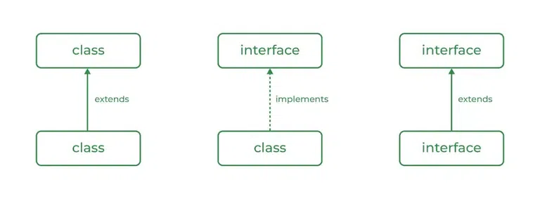
Relationship Between Class and Interface
A class can extend another class similar to this an interface can extend another interface.
But only a class can extend to another interface, and vice-versa is not allowed.

Slide 31
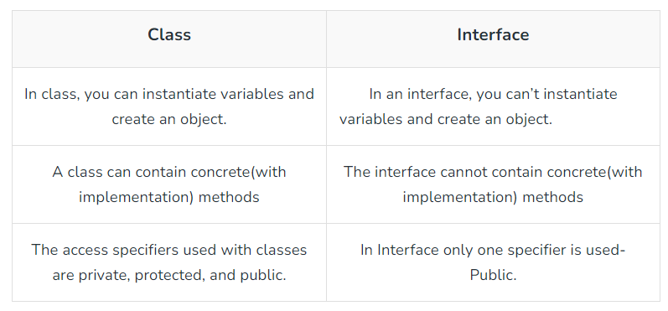
Difference Between Class and Interface
Although Class and Interface seem the same there have certain differences between Classes and Interface.

Slide 32
New Feature Added in java 8
default methods:
We can now add default implementation for interface methods. This default implementation has a special use and does not affect the intention behind interfaces.
Static Methods: we can now define static methods in interfaces that can be called independently without an object.

Slide 33
Types of Interfaces
1. Functional Interface:
Functional Interface is an interface that has only pure one abstract method.
It can have any number of static and default methods
When an interface contains only one single abstract method, then it is known as a Functional Interface.
Examples of Functional Interfaces:
Runnable : It contains only run() method
ActionListener : It contains only actionPerformed()
ItemListener : It contains only itemStateChanged() method

Slide 34
2. Marker Interface:
An interface that does not contain any methods, fields, Abstract Methods, and any Constants is Called a Marker interface.
Also, if an interface is empty, then it is known as Marker Interface.
The Serializable and the Cloneable interfaces are examples of Marker interfaces.

Slide 35
Lambda Expression
Lambda expression is a new and important feature of Java which was included in Java SE 8.
It provides a clear and concise way to represent one method interface using an expression.
It is very useful in collection library. It helps to iterate, filter and extract data from collection.

Slide 36
The Lambda expression is used to provide the implementation of an interface which has functional interface.
It saves a lot of code.
In case of lambda expression, we don't need to define the method again for providing the implementation.
Here, we just write the implementation code.
Java lambda expression is treated as a function, so compiler does not create .class file.

Slide 37
Syntax of Lambda Expression
(argument-list) -> {body}
Java lambda expression is consisted of three components.
1) Argument-list: It can be empty or non-empty as well.
2) Arrow-token: It is used to link arguments-list and body of expression.
3) Body: It contains expressions and statements for lambda expression.
No Parameter Syntax
() -> {
//Body of no parameter lambda
}

